Slide 1
Paper presentation: CONVEX OPTIMIZATION FOR FAST IMAGE DEHAZING
Author: Jiaxi He, Cishen Zhang, Ran Yang, Kai Zhu
Teacher: Carrson C. Fung
Speaker: Chen Shun Liu
0656124

Slide 2
Introduction - Image Dehazing
Haze occurs when dust and smoke particles accumulate in atmosphere.
The image dehazing problem is to apply post processing of hazed images to remove the haze effects.
In this paper, Haar wavelet transform is applied to derive a subband hazed image model with reduced dimension.
A convex optimization problem is formulate. It’s solution is sufﬁcient for reconstruction of the haze free image.

Slide 3
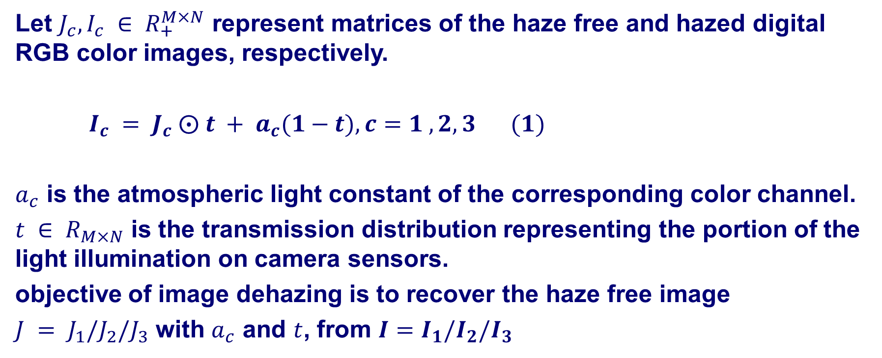
THE HAZED IMAGE MODEL
Let $J_{c},I_{c} ∈ R_{+}^{M×N}$ represent matrices of the haze free and hazed digital RGB color images, respectively.
$I_{c} = J_{c} ⨀ t + a_{c}(1−t),c=1 ,2,3$ $(1)$
$a_{c}$ is the atmospheric light constant of the corresponding color channel.
$t ∈ R_{M×N}$ is the transmission distribution representing the portion of the light illumination on camera sensors.
objective of image dehazing is to recover the haze free image
$J = J_{1}/J_{2}/J_{3}$ with $a_{c}$ and $t$, from ${I=I}_{1}/I_{2}/I_{3}$
Notes:
The optical model widely used to represent hazed images is equation (1).

Slide 4
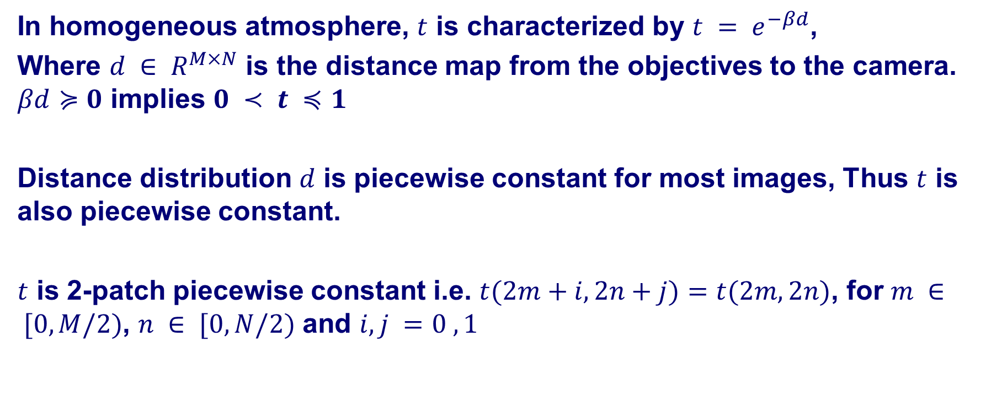
Discrete Haar wavelet transform
In homogeneous atmosphere, $t$ is characterized by $t = e^{−βd}$,
Where $d ∈ R^{M×N}$ is the distance map from the objectives to the camera. $βd≽0$ implies $0 ≺ t ≼1$
Distance distribution $d$ is piecewise constant for most images, Thus $t$ is also piecewise constant.
$t$ is 2-patch piecewise constant i.e. $t(2m+i,2n+j)=t(2m,2n)$, for $m ∈ [0,M/2)$, $n ∈ [0,N/2)$ and $i,j =0 ,1$

Slide 5
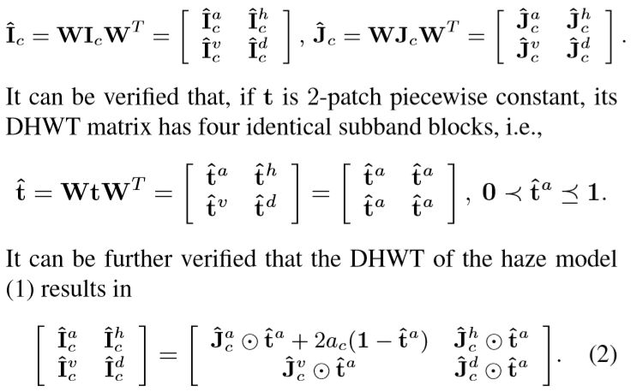
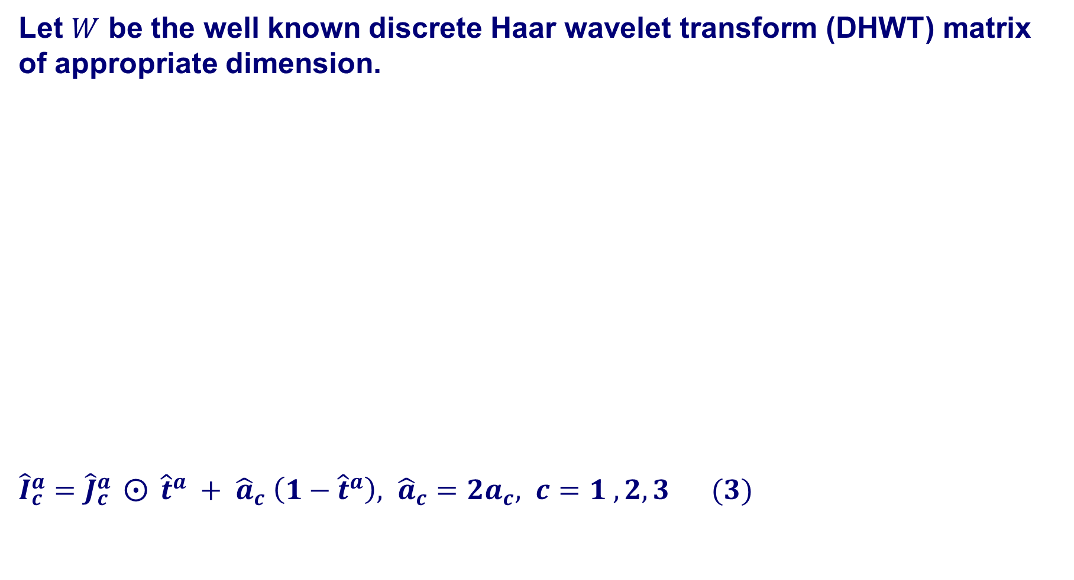
Discrete Haar wavelet transform
Let $W$ be the well known discrete Haar wavelet transform (DHWT) matrix of appropriate dimension.
${\hat{I}}_{c}^{a}={\hat{J}}_{c}^{a} ⨀{ {\hat{t}}^{a}} + {\hat{a}}_{c} \left(1−{\hat{t}}^{a}\right), {\hat{a}}_{c}=2a_{c}, c=1 ,2,3$ $(3)$

Slide 6
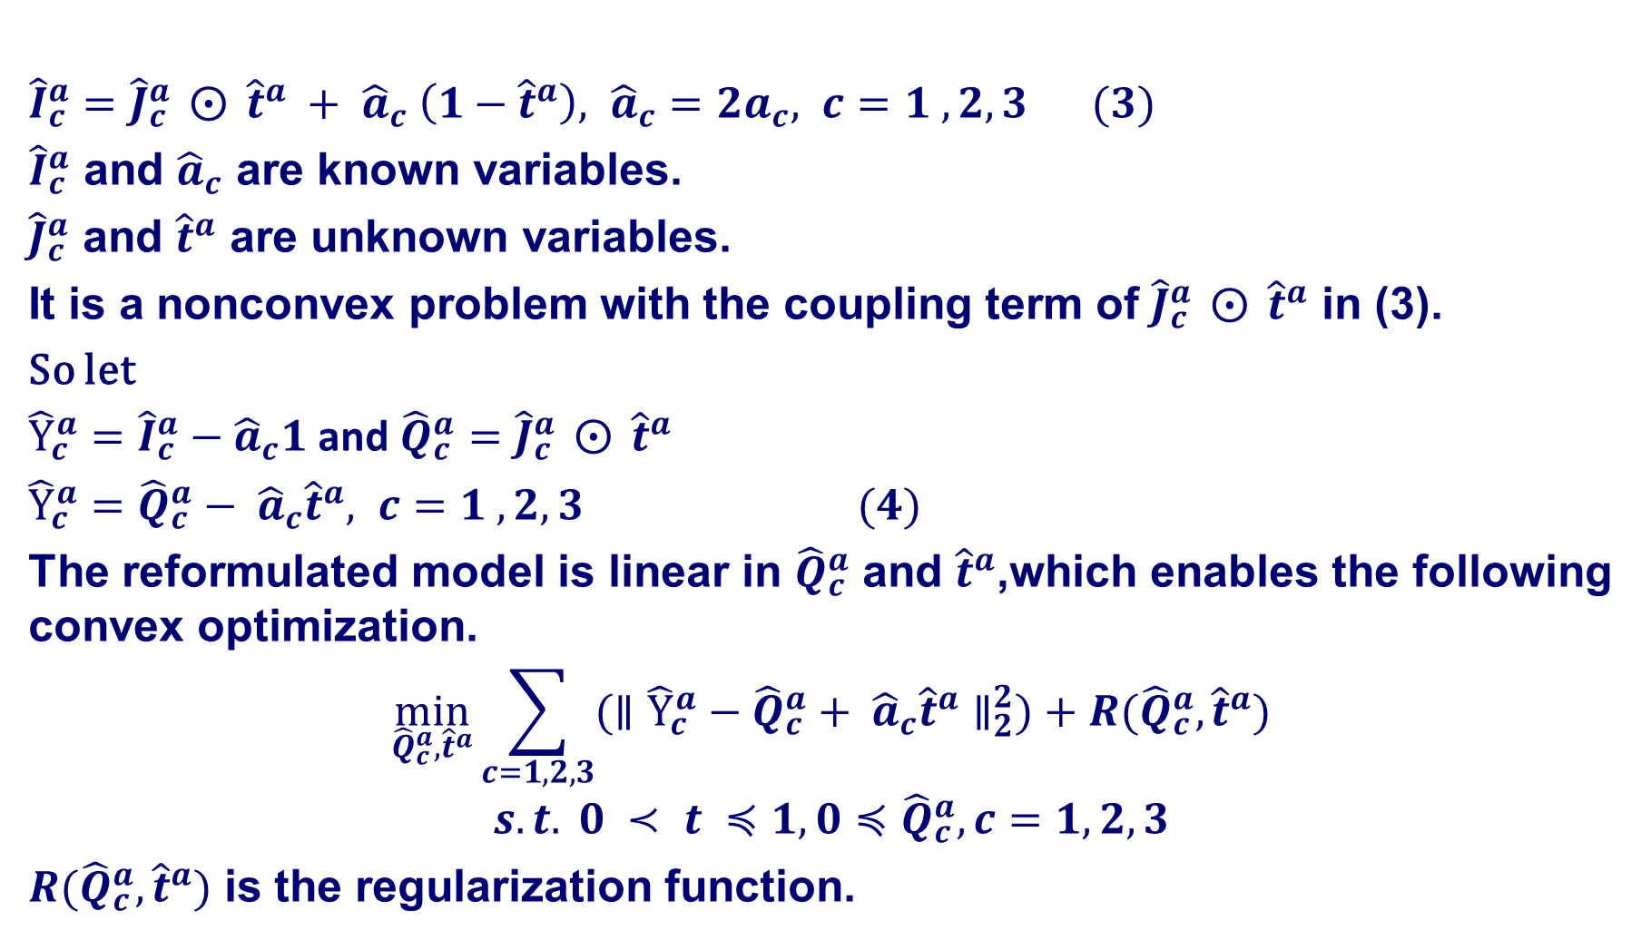
THE CONVEX OPTIMIZATION
${\hat{I}}_{c}^{a}={\hat{J}}_{c}^{a} ⨀{ {\hat{t}}^{a}} + {\hat{a}}_{c} \left(1−{\hat{t}}^{a}\right), {\hat{a}}_{c}=2a_{c}, c=1 ,2,3$ $(3)$
${\hat{I}}_{c}^{a}$ and ${\hat{a}}_{c}$ are known variables.
${\hat{J}}_{c}^{a}$ and ${\hat{t}}^{a}$ are unknown variables.
It is a nonconvex problem with the coupling term of ${\hat{J}}_{c}^{a} ⨀{ {\hat{t}}^{a}}$ in (3).
So let
${\hat{Y}}_{c}^{a}={\hat{I}}_{c}^{a}−{\hat{a}}_{c}1$and ${\hat{Q}}_{c}^{a}={\hat{J}}_{c}^{a} ⨀{ {\hat{t}}^{a}}$
${\hat{Y}}_{c}^{a}={\hat{Q}}_{c}^{a}− {\hat{a}}_{c}{\hat{t}}^{a}, c=1 ,2,3$ $(4)$
The reformulated model is linear in ${\hat{Q}}_{c}^{a}$ and ${\hat{t}}^{a}$,which enables the following convex optimization.
$$\min_{{\hat{Q}}_{c}^{a},{\hat{t}}^{a}}{\sum_{c=1,2,3}{({∥{\hat{Y}}_{c}^{a}−{\hat{Q}}_{c}^{a}+ {\hat{a}}_{c}{\hat{t}}^{a}∥}_{2}^{2})}}+R({\hat{Q}}_{c}^{a},{\hat{t}}^{a})$$
$$s.t. 0 ≺ t ≼1, 0≼{\hat{Q}}_{c}^{a},c=1,2,3$$
$R({\hat{Q}}_{c}^{a},{\hat{t}}^{a})$ is the regularization function.

Slide 7
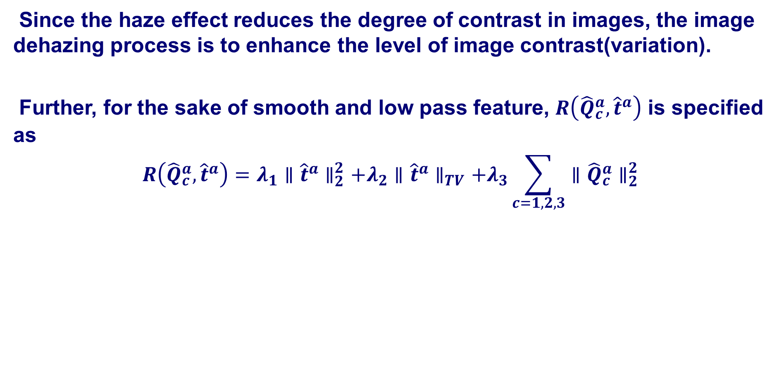
Selection of the regularization function
Since the haze effect reduces the degree of contrast in images, the image dehazing process is to enhance the level of image contrast(variation).
Further, for the sake of smooth and low pass feature, $R\left({\hat{Q}}_{c}^{a},{\hat{t}}^{a}\right)$ is specified as
$$R\left({\hat{Q}}_{c}^{a},{\hat{t}}^{a}\right)=λ_{1}{∥{\hat{t}}^{a}∥}_{2}^{2}+λ_{2}∥{\hat{t}}^{a}∥_{TV}+λ_{3}\sum_{c=1,2,3}{{∥{\hat{Q}}_{c}^{a}∥}_{2}^{2}}$$

Slide 8
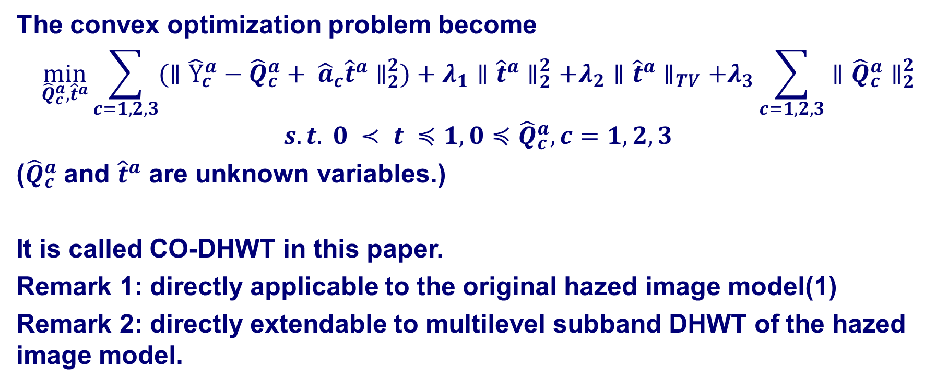
CO-DHWT
The convex optimization problem become
$$\min_{{\hat{Q}}_{c}^{a},{\hat{t}}^{a}}{\sum_{c=1,2,3}{({∥{\hat{Y}}_{c}^{a}−{\hat{Q}}_{c}^{a}+ {\hat{a}}_{c}{\hat{t}}^{a}∥}_{2}^{2})}}+λ_{1}{∥{\hat{t}}^{a}∥}_{2}^{2}+λ_{2}∥{\hat{t}}^{a}∥_{TV}+λ_{3}\sum_{c=1,2,3}{{∥{\hat{Q}}_{c}^{a}∥}_{2}^{2}}$$
$$s.t. 0 ≺ t ≼1, 0≼{\hat{Q}}_{c}^{a},c=1,2,3$$
(${\hat{Q}}_{c}^{a}$ and ${\hat{t}}^{a}$ are unknown variables.)
It is called CO-DHWT in this paper.
Remark 1: directly applicable to the original hazed image model(1)
Remark 2: directly extendable to multilevel subband DHWT of the hazed image model.

Slide 9
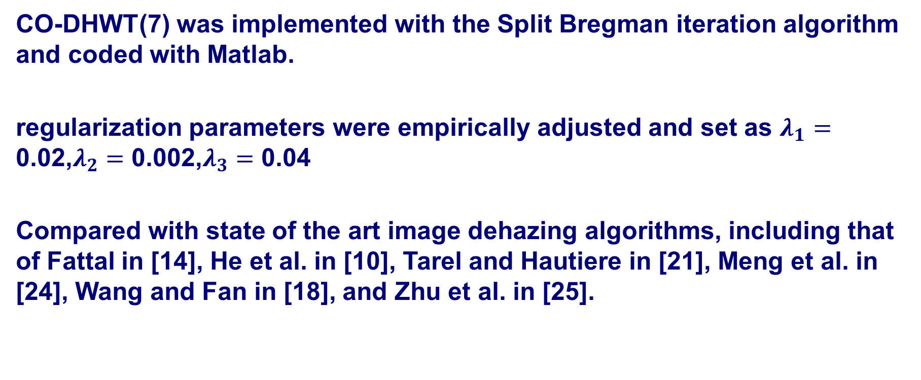
COMPUTATIONAL RESULTS
CO-DHWT(7) was implemented with the Split Bregman iteration algorithm and coded with Matlab.
regularization parameters were empirically adjusted and set as $λ_{1}=\text{0.0}\text{2,}λ_{2}=\text{0.}\text{0}\text{02}\text{,}λ_{3}=\text{0.0}\text{4}$
Compared with state of the art image dehazing algorithms, including that of Fattal in [14], He et al. in [10], Tarel and Hautiere in [21], Meng et al. in [24], Wang and Fan in [18], and Zhu et al. in [25].

Slide 10
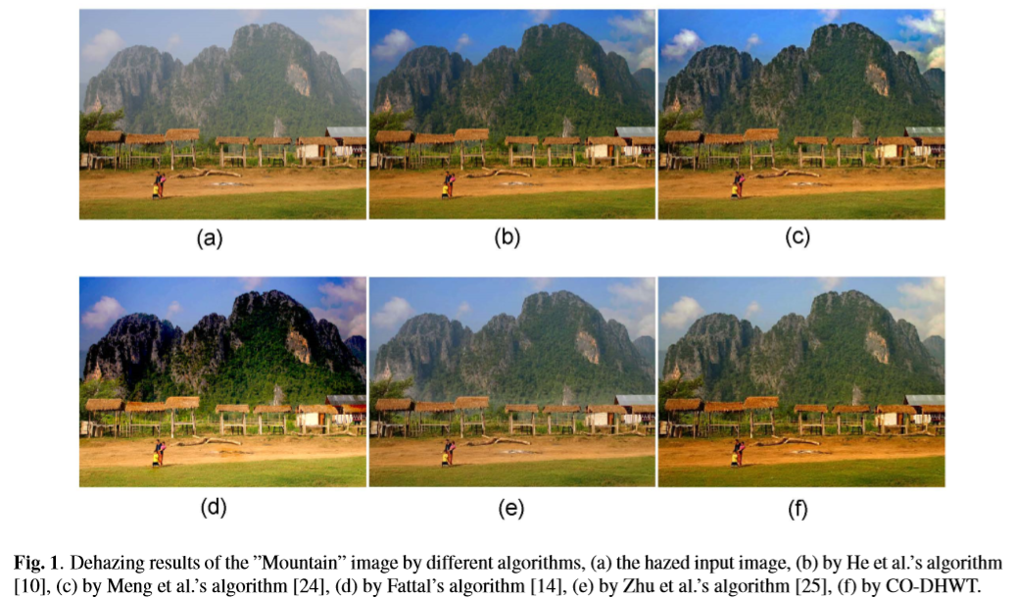

Slide 11
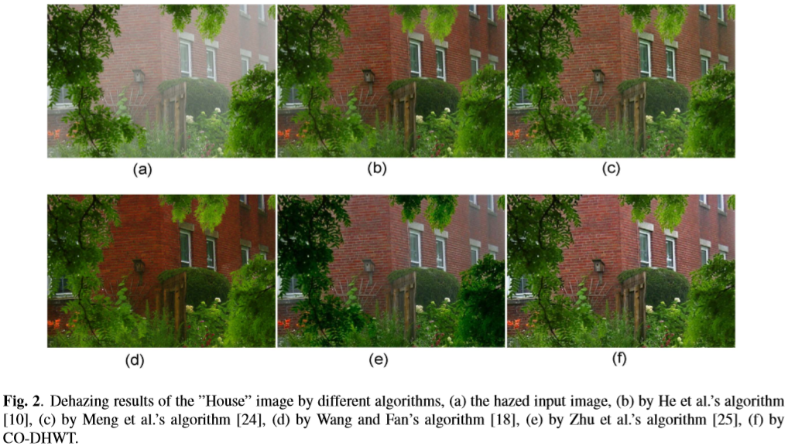

Slide 12
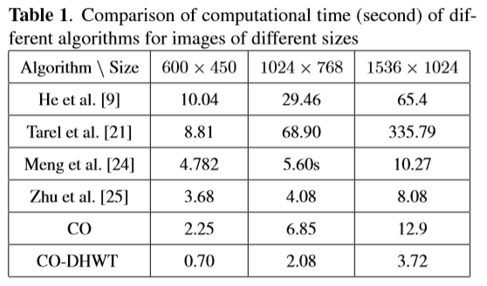
Computational time

Slide 13
CONCLUSION
By reformulating in the hazed image model, this paper has presented a convex optimization formulation for the image dehazing problem in the low pass subband of the Haar wavelet transform domain.
Its dehazing results outperform state of the art image dehazing algorithms.
Notes:
Convexity
Reformulation
What kind of problem

